Slide 1
InVEST: Schistosomiasis

Slide 2
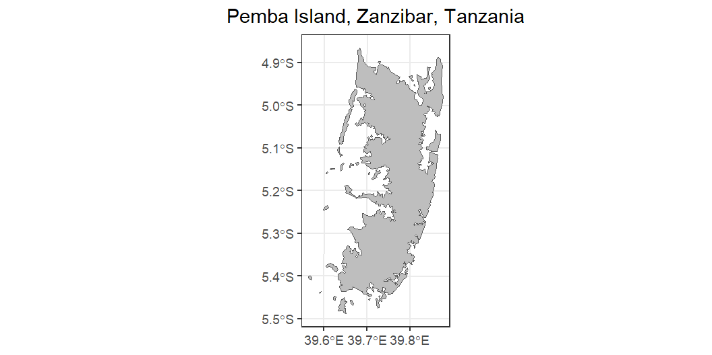
Scenario 1: Pemba
|---------|---------|---------|---------|
=========================================
|---------|---------|---------|---------|
=========================================
|---------|---------|---------|---------|
=========================================
|---------|---------|---------|---------|
=========================================
Input data: AOI

Slide 3
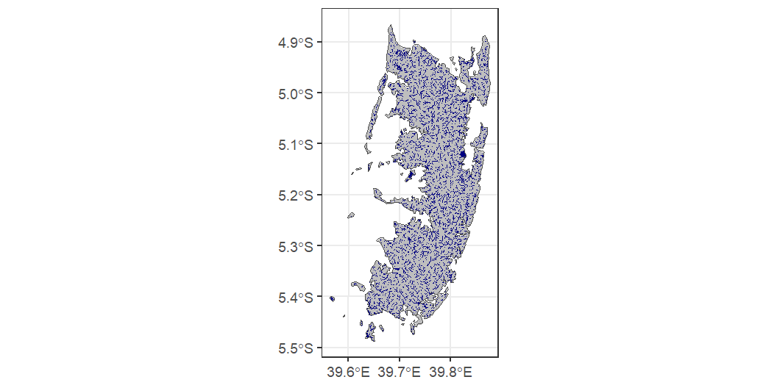
Input data: Water

Slide 4
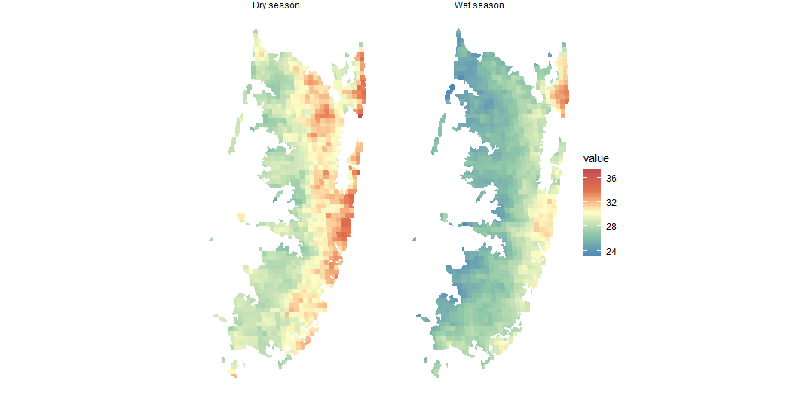
Input data: Average temperature

Slide 5
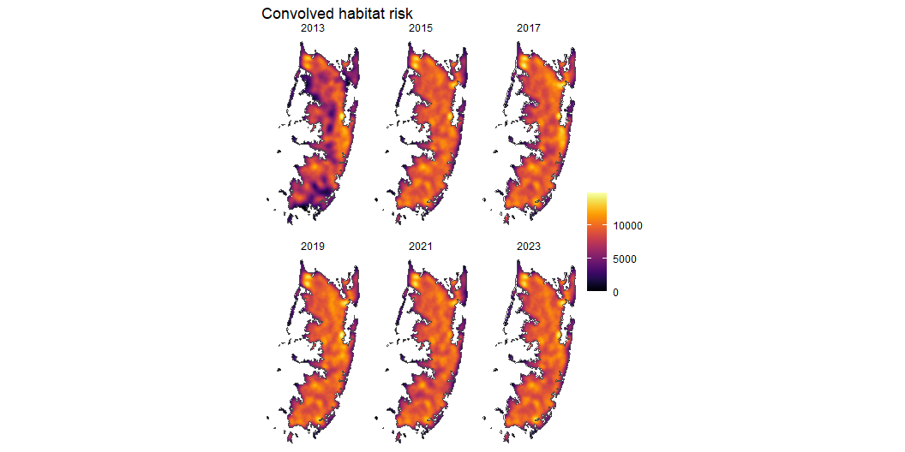
…
Prediction: Compare temperature inputs
MODIS 2015 - 2026 vs No Temp.
There is a difference, though minor, which might be because there isn’t a lot of temperature variability in the MODIS data or inheriently because there is little topography and thus temperature variation across Pemba.
Prediction: Compare early and late elimination scenarios
Erradication began in 2012, the earliest data is from ZEST 2013. The ‘best’ recent data is 2021, though data collection went through 2024.

Slide 6
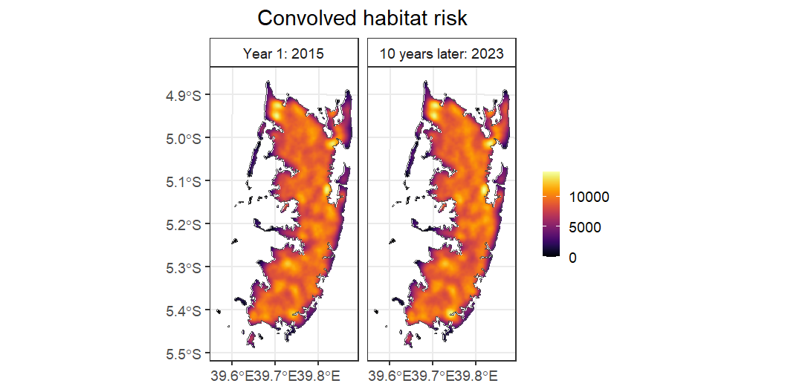
Early and Late

Slide 7
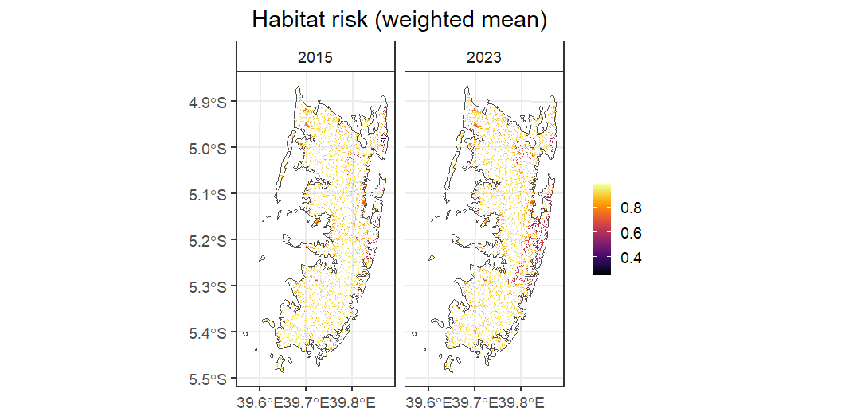
Suitability: Habitat risk

Slide 8
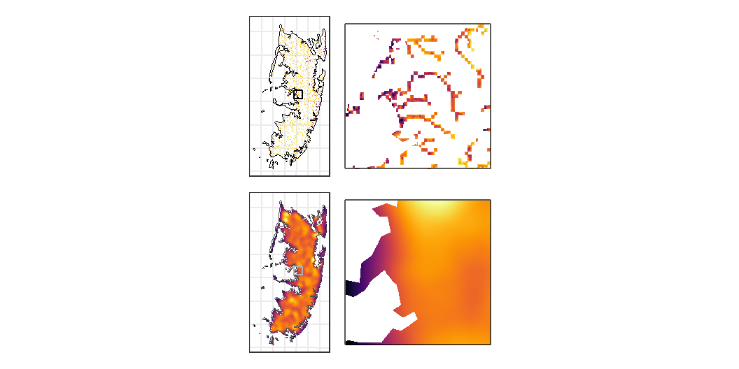
Habitat suitability and convoluted risk

Slide 9
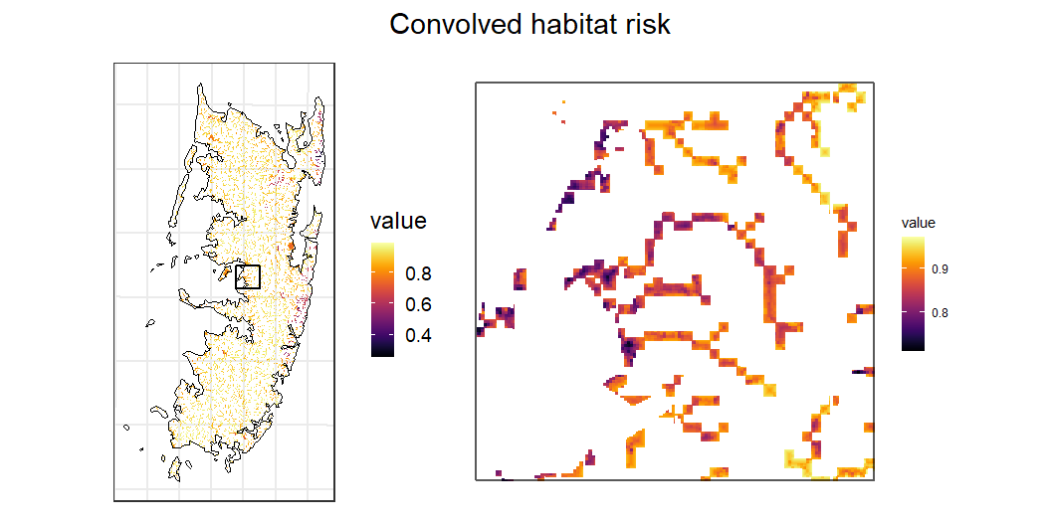

Slide 10
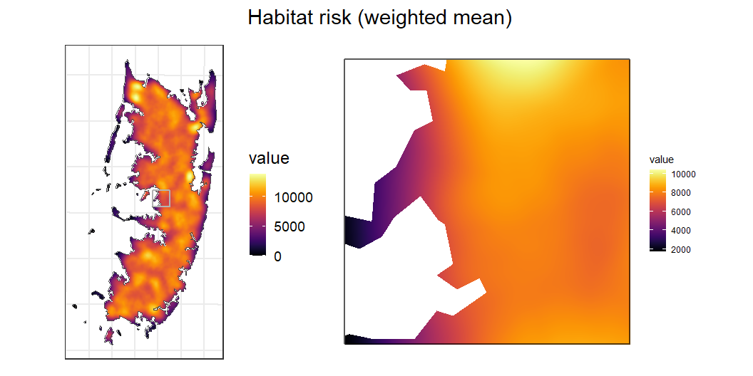

Slide 11
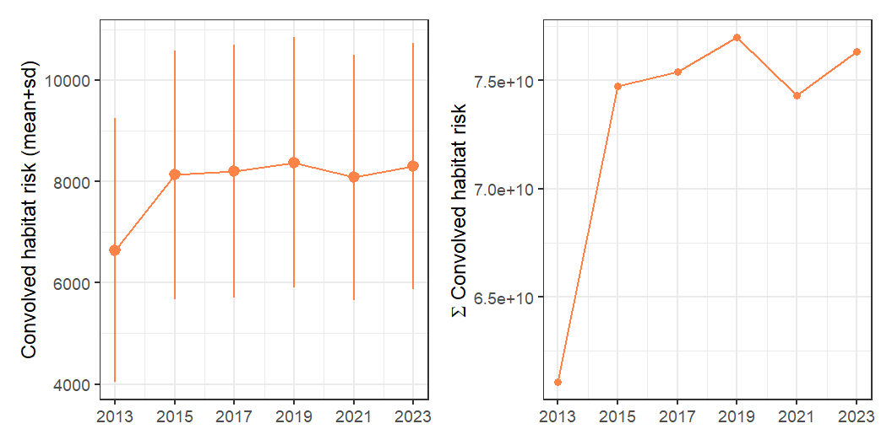
Prediction: Convolved risk does not change overtime
Convolved risk stays stable 2015-2023 (average across the entire island)

Slide 12
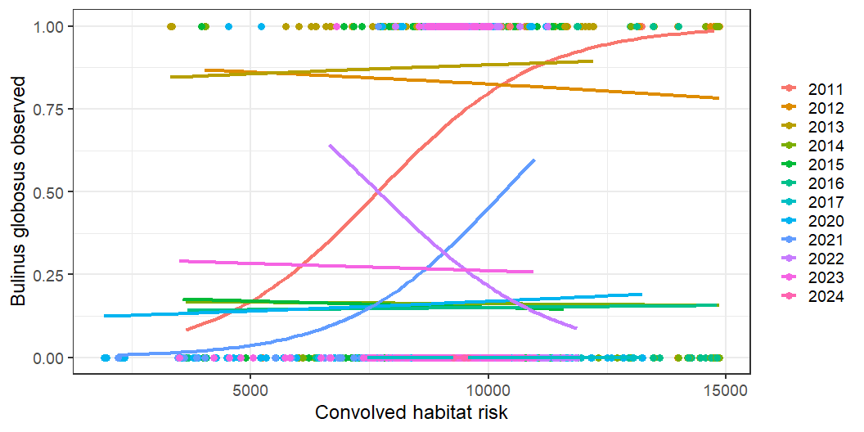
Snails found and risk have no/slightly negative relationship

Slide 13
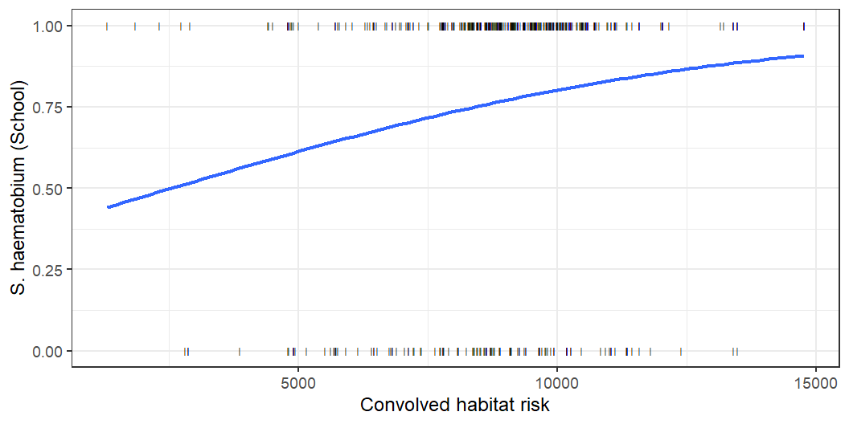
Schools and convolved risk

Slide 14
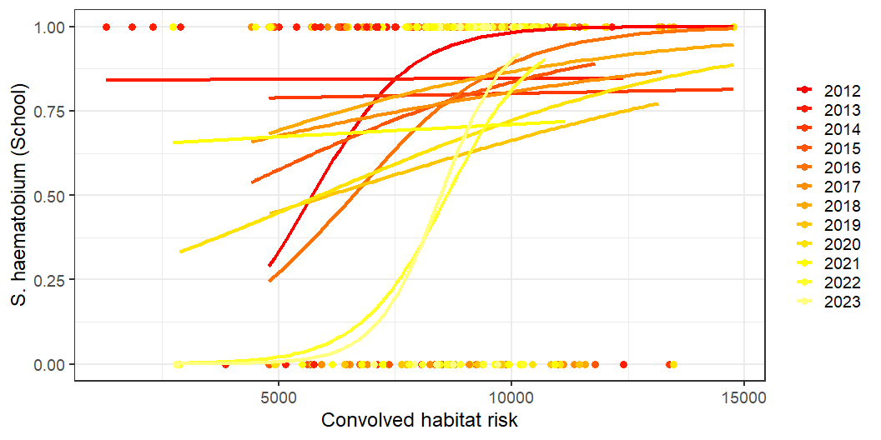

Slide 15
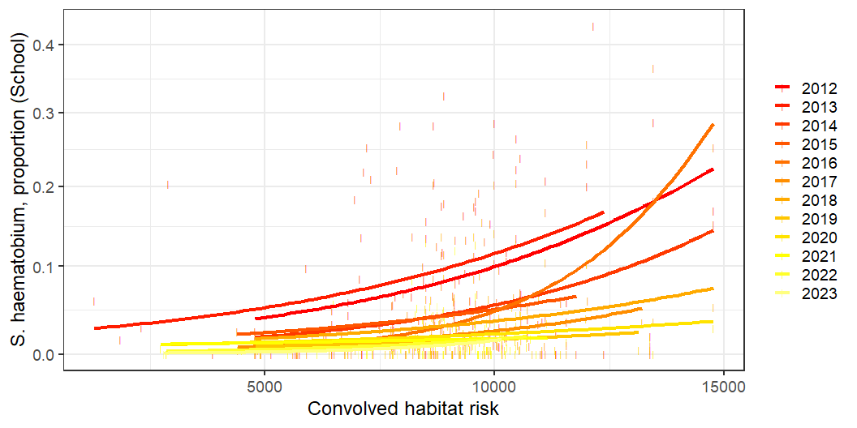

Slide 16
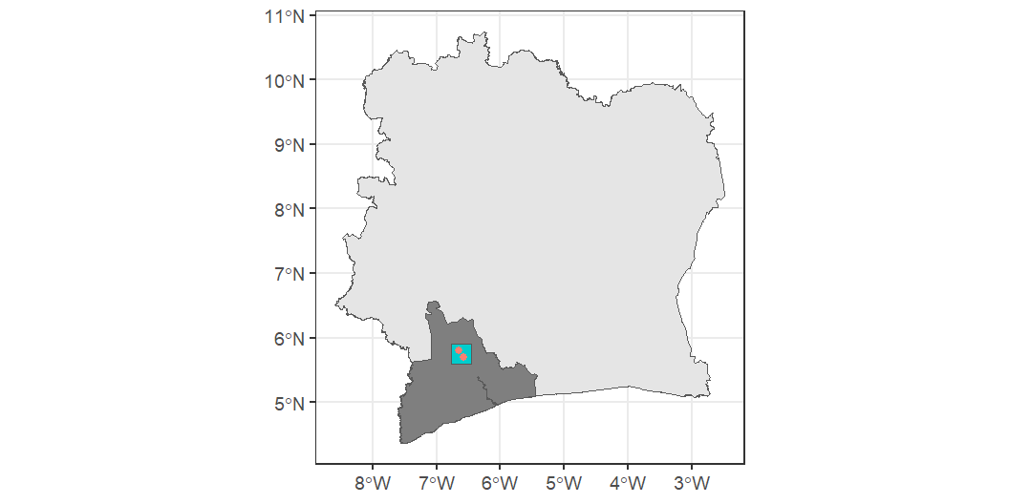
Scenario: Soubre and Gribo-Popoli Hydroelectric Power Stations
|---------|---------|---------|---------|
=========================================
|---------|---------|---------|---------|
=========================================
|---------|---------|---------|---------|
=========================================
Dam locations

Slide 17
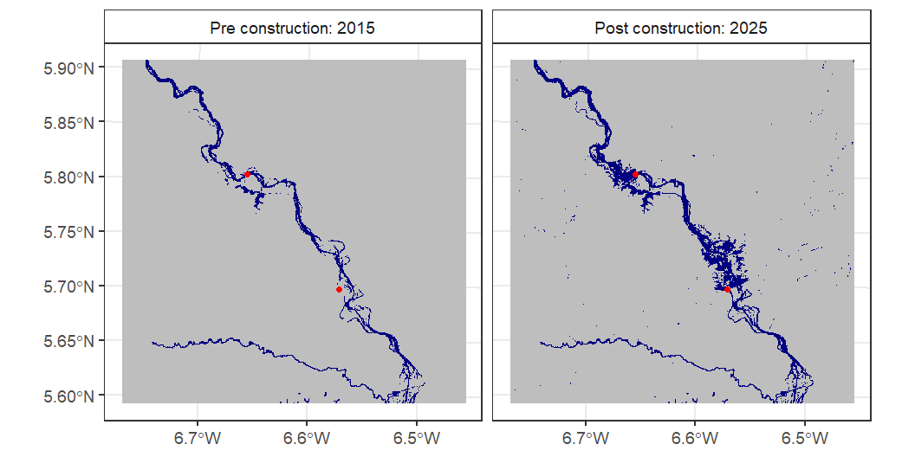
Water changes

Slide 18
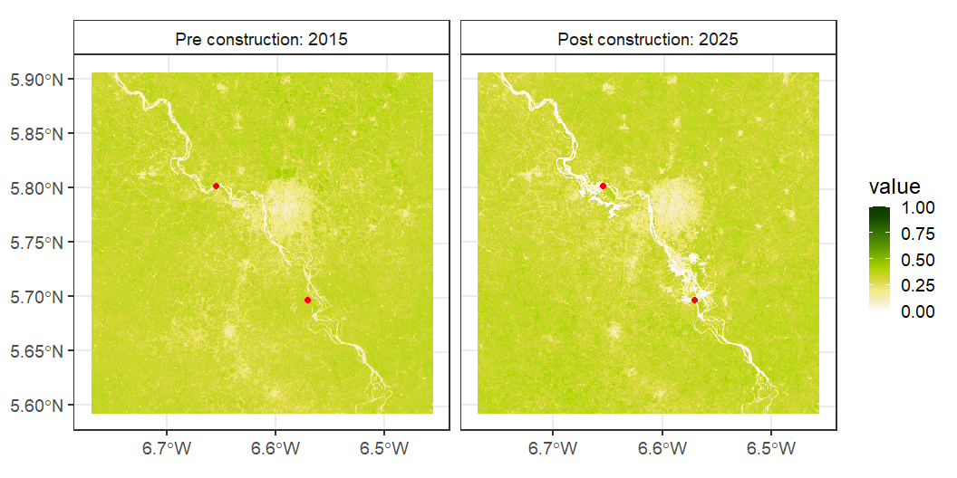
NDVI

Slide 19
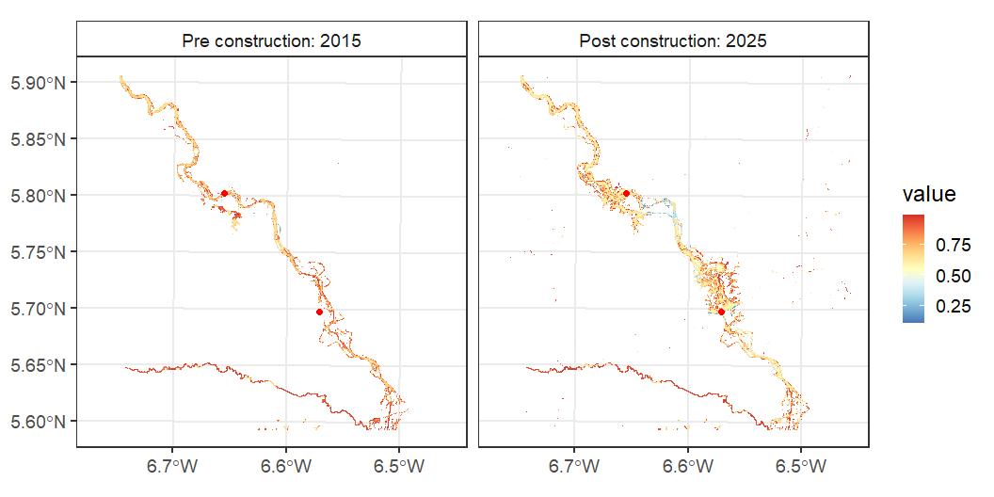
Habitat suitability changes

Slide 20
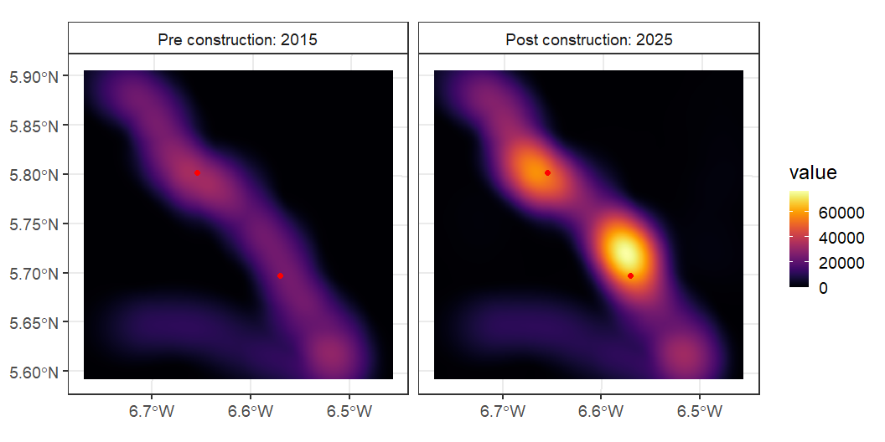
Convolved risk

Slide 21
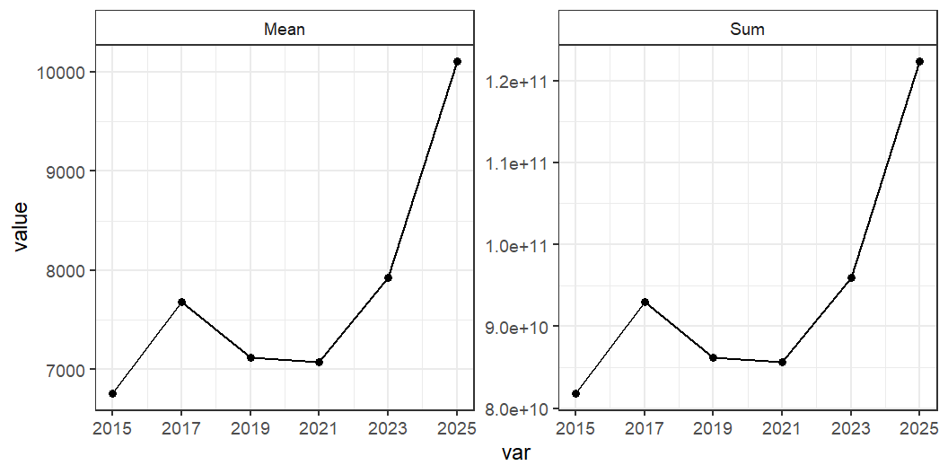
Mean and total risk increase over the construction period

Slide 22
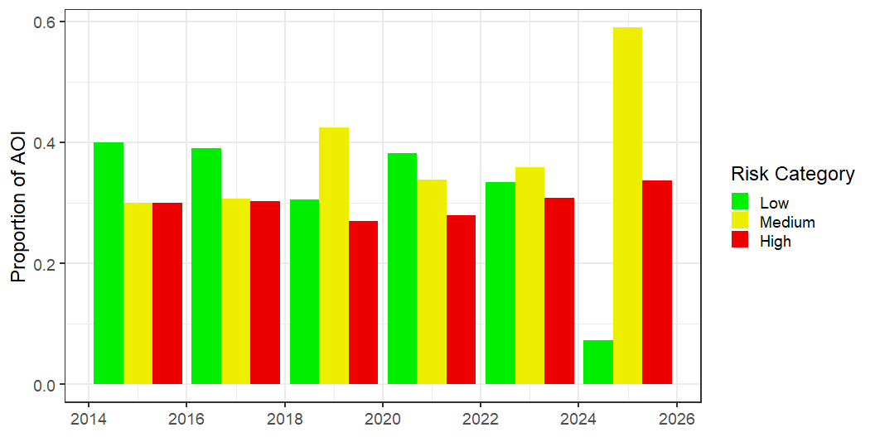
<ggplot2::labels> List of 2
$ x: NULL
$ y: chr "Convolved Risk in AOI"
Risk as proportion of AOI as low/med/high risk
Using 2015 model define low/med/high (<0.3 quantile = low; >0.7 quantile = high)
0% 40% 70%
0.00000 33.24016 9671.62783
|---------|---------|---------|---------|
=========================================

Slide 23
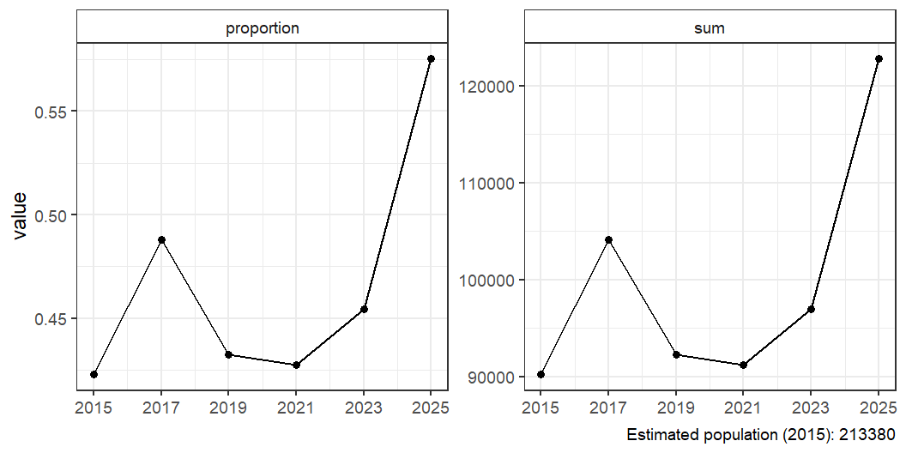
Population at risk: Using fixed (2015) population estimate
|---------|---------|---------|---------|
=========================================

Slide 24
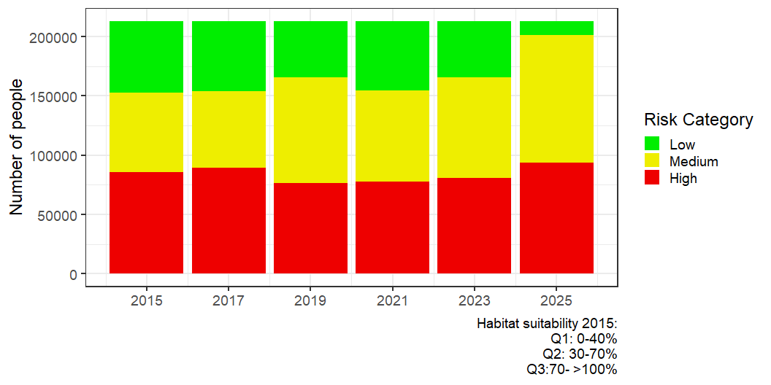
Population at risk: Using fixed (2015) population estimate

